Slide 1
Virginia Tax
Overview of New Hire Forms
January 2025

Slide 2
What Forms will be Covered Today
Introduction
I-9
W-4 and VA-4
Direct Deposit
Personal Information and Emergency Contact
Prior State Service

Slide 3
Welcome to Virginia Tax
Introduction
Congratulations on your new job! We’re excited for you to join us.
This is instructions on how to complete the 6 new hire forms that you will need to bring with you on your first day. You will also need to bring supporting I-9 documents and a letter from your bank or a voided check with your name on the account.
We look forward to meeting you.

Slide 4
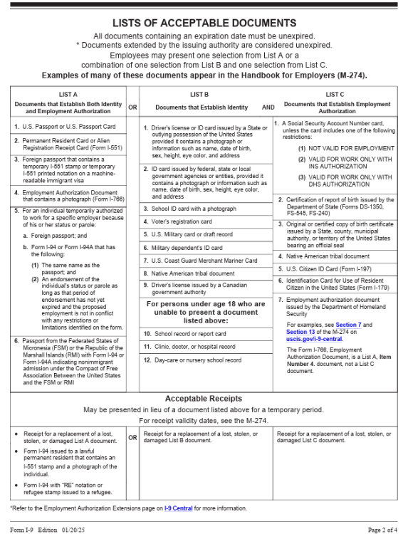
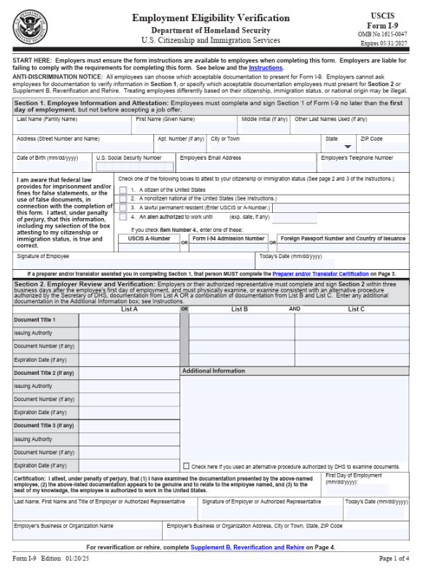
I-9 Form – Verifies Identity and Right to Work
Complete Section I only
On your first day, you will need a document from List A OR Documents from List B AND List C.

Slide 5
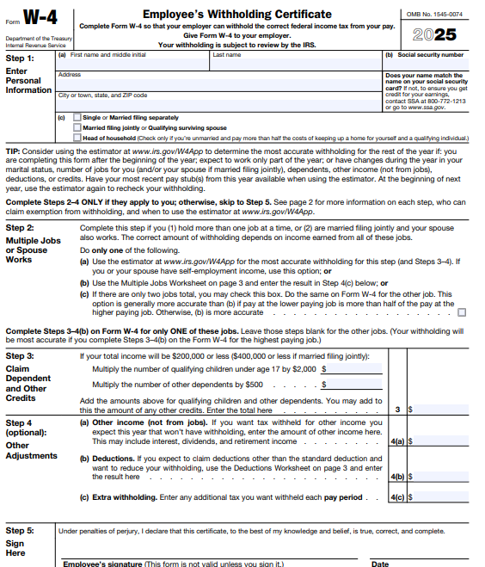
W-4 Form – Federal Withholding Certificate
Complete all areas in BLUE Sections 3 & 4 are Optional
Optional

Slide 6
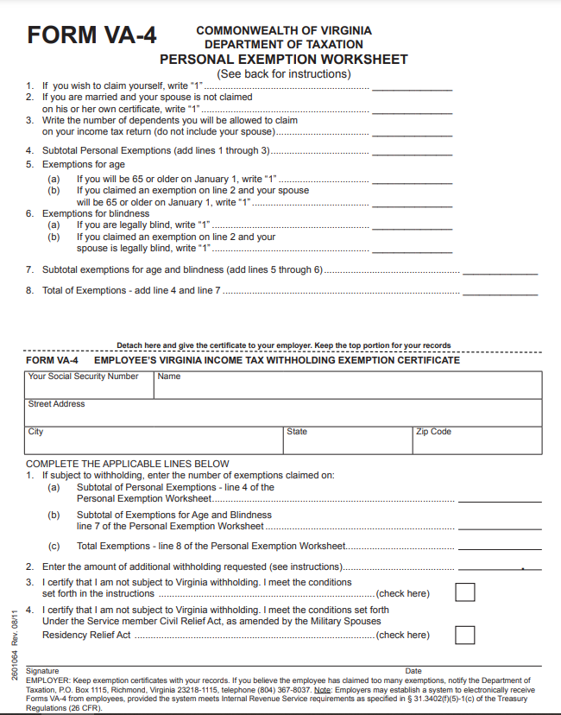
VA-4 Form – Commonwealth Withholding Certificate
You may use the top worksheet to assist you with completing this form. Complete the bottom demographic section and line 1 a, b, and c and number 2. For number 2, if you do not want additional withholding, enter 0.00 in that line. Only complete line 3 or 4 if it applies. Sign and date the form.

Slide 7
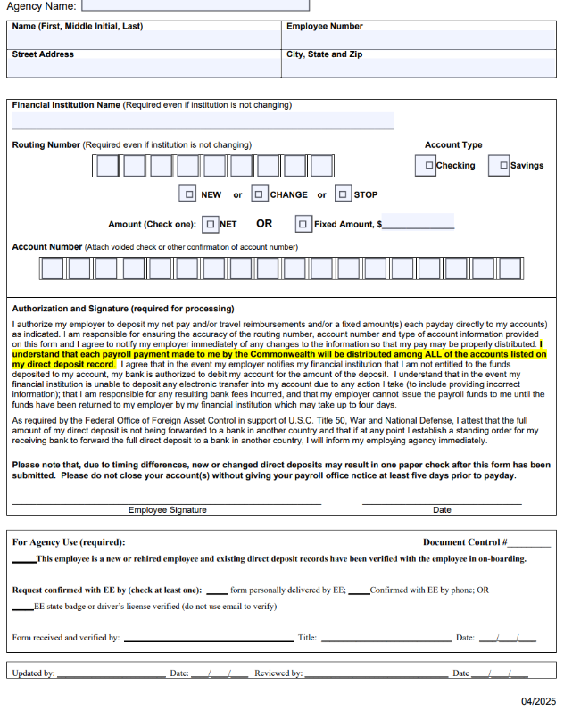
Employee Direct Deposit Form
Complete all areas in Blue. Remember to sign and date. On your first day, please bring a voided check with your name on the account or a letter from your bank with your routing and account numbers in order to receive direct deposit.

Slide 8
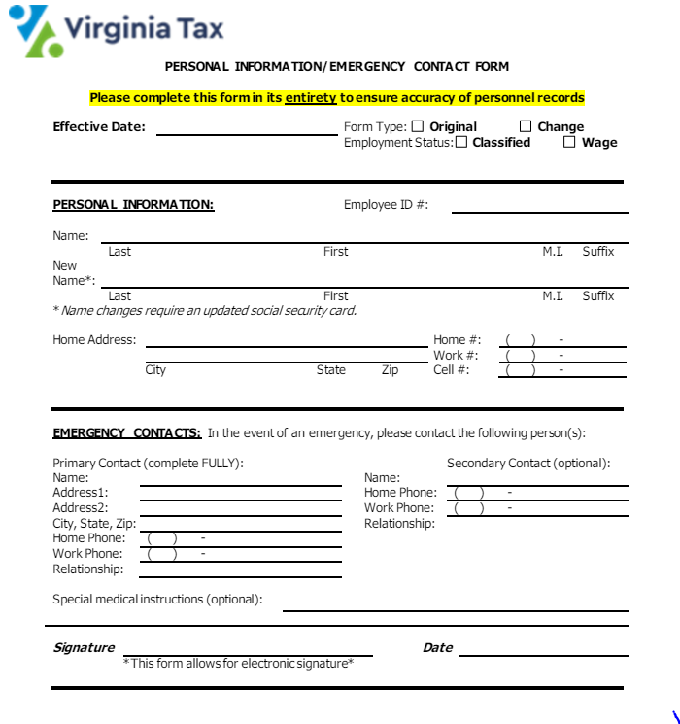
Personal Information/Emergency Contact Form
Please complete the entire form starting with the Personal Information section. Sign and date.

Slide 9
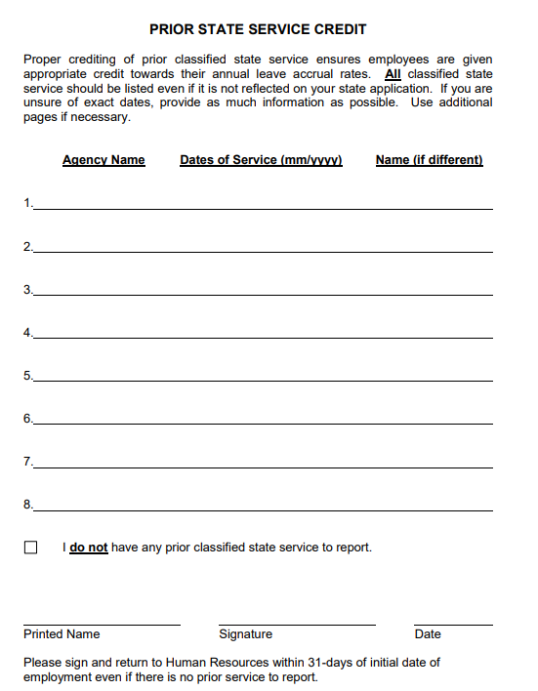
Prior State Service Form
Please complete the entire form. If you do not have state service, please check the box that you do not have state service, print your name, sign and date.

Slide 10
Thank You
If you have any questions, please contact:
Human Resources at 804.786.3608

